Slide 1
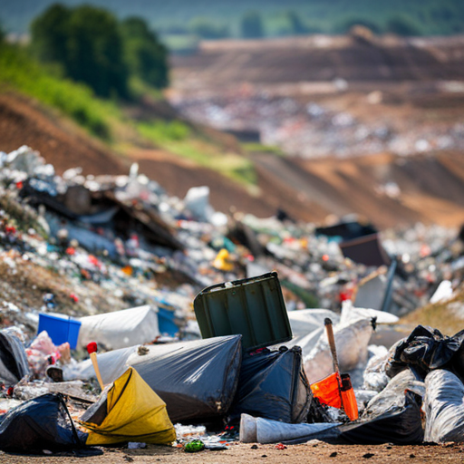

WASTE MANAGMENT
SMART BINS
WASTE LEVEL SENSORS

Slide 2
THE BOYS
MEMBER 1
MEMBER 2
MEMBER 3

Slide 3
STAKE HOLDERS
University Administration
Facilities Management Department
Students and Faculty
Environmental Groups and NGOs
Local Community
Waste Management Service Providers
Regulatory Agencies
Investors or Funders

Slide 4
CONTENTS OF THIS PRESENTATION
1 | Introduction
2 | Sequence of Events
3 | Cost Breakdown
4 | Investment Appraisal
5 | Legislation
6 | Design
7 | Risk Analysis
8 | Gantt Chart and Network diagram

Slide 5
INTRODUCTION
Management of wastes should be equally within university compounds for cleanliness and sustainability. Smart Bins and Waste Level Sensors are innovative solutions:
Smart Bins:
Sellers can tag the products on high fashion store shelves so that if they are tapped the items are forwarded to the shopping basket through this app.
Give the internet connection for more information and present a targeted advertisement.
Provide income and access to data/information.
Waste Level Sensors:
Monitor refreshing rates in real time.
Provide on-demand waste collection.
Save money and make things better for the Earth.
These technologies provide a solution using refinement and advanced placement of the collection process and encourage sustainability.

Slide 6
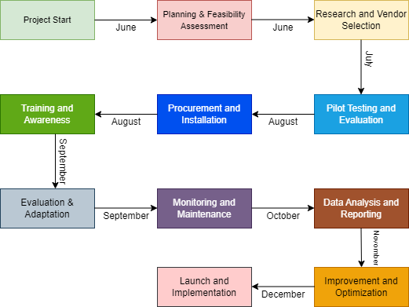
Sequence of events

Slide 7
Project Justification
Efficiency Enhancement: Enhancing waste collection efficiency; managing overflow in the incidents and also saving operational costs.
Sustainability Goals: Line up environmental consciousness, decrease landfill waste and of course create less burden on the ecosystem.
Data-driven decision-making: Apply live data to achieve routes that are optimized, resources that are appropriately allocated, and, finally, to eliminate unnecessary consumption in the waste management process.
Technological Innovation: Feature the use of environmentally friendly strategies, make sure that internet access is available, and encourage people to be digitally literate.
Health and Safety: Make efforts to avoid the potentially hazardous conditions associated with waste that is not disposed of properly.

Slide 8
OPTIONS
SMART BINS
WASTE LEVEL SENSORS
Not only function as trash cans and Wi-Fi sources for the campus but also serve as venues for productive activities.
Entertain the thought of advertising on digital billboards to trigger potential revenue streams.
Increase interactivity using digital displays explaining the environment and responsible for community engagement.
Draw data on the waste generation and user behavior for various scenarios, which could be a very good basis for the optimization.
Develop a technology that would enable monitoring waste levels in real-time in bins.
Implement aggressive provisions for proactive wastage compaction by employing machine learning algorithms that detect fill levels and generate optimal routes for collection.
Contribute to achieving the efficiency goals by helping to cut cruising time not used in direct collection from users and unnecessary trip journeys.
Help cut down the environmental impact of waste management processing by preventing overflow mishaps and sorting routes efficiently.

Slide 9
Financial Analysis(SMART BINS)
INCOME
Description | Monthly (£) | Annual (£)
Monthly earnings from WiFi hotspots | £250 | £3,000
Advertisement revenue | £1,800 | £21,600
Savings from university notices | - | FREE
Savings from efficient route planning | - | £12,000
Savings from personal salaries | - | £9,600
Total | £2,050 | £46,200

Slide 10
Financial Analysis(SMART BINS)
EXPENSES
Description | Monthly (£) | Annual (£)
Smart bin price (25 units) | - | £100,000(one time investment)
Repairs and maintenance | £1,000 | £12,000
Screen breakdown insurance | £150 | £1,800
Components replacement cost | - | £7,000
Repairing services cost | - | £2,000
Risk management budget(Cybersecurity firewall subscription, Fire hazard insurance) | - | £8,000
Total | £1,750 | £130,800

Slide 11
Cash flow option 1
Year | Annual Income (£) | Annual Expenses (£) | Net Income (£)
1 | £46,200 | £130,800 | £-84,600
2 | £46,200 | £30,800 | £15,400
3 | £46,200 | £30,800 | £15,400
4 | £46,200 | £30,800 | £15,400
5 | £46,200 | £30,800 | £15,400
6 | £46,200 | £30,800 | £15,400
7 | £46,200 | £30,800 | £15,400
8 | £46,200 | £30,800 | £15,400
9 | £46,200 | £30,800 | £15,400
10 | £46,200 | £30,800 | £15,400

Slide 12
Financial Analysis(Waste Level Sensors)
EXPENSES
Description | Monthly (£) | Annual (£)
Waste Level Sensors (25 units) | - | £50,000(one time investment)
Repairs and maintenance | £1,000 | £12,000
Screen breakdown insurance | £150 | £1,800
Components replacement cost | - | £7,000
Repairing services cost | - | £2,000
Risk management budget(Cybersecurity firewall subscription, Fire hazard insurance) | - | £8,000
Total | £1,750 | £80,800

Slide 13
Financial Analysis(Waste Level Sensors)
INCOME
Description | Monthly (£) | Annual (£)
Advertisement revenue | £1,800 | £21,600
Savings from university notices | - | FREE
Savings from efficient route planning | - | £12,000
Savings from personal salaries | - | £9,600
Total | £1,800 | £42,600

Slide 14
Cash flow option 2
Year | Initial Investment (£) | Annual Income (£) | Annual Expenses (£) | Net Cash Flow (£)
1 | -£80,800 | £42,600 | £30,800 | -£69,000
2 |  | £42,600 | £30,800 | £11,800
3 |  | £42,600 | £30,800 | £11,800
4 |  | £42,600 | £30,800 | £11,800
5 |  | £42,600 | £30,800 | £11,800
6 |  | £42,600 | £30,800 | £11,800
7 |  | £42,600 | £30,800 | £11,800
8 |  | £42,600 | £30,800 | £11,800
9 |  | £42,600 | £30,800 | £11,800
10 |  | £42,600 | £30,800 | £11,800

Slide 15
Investment appraisal option 1
Investment appraisal option 2
Data | Value
Initial Investment | £130,800
Net Cash Flow per year | £15,400
Data | Value
Initial Investment | £80,800
Net Cash Flow per year | £11,800
Metric | Value
Payback Period | 8.494 years
Net Present Value (NPV) | £4,088.97
Internal Rate of Return (IRR) | 11.20%
Metric | Value
Payback Period | 6.847 years
Net Present Value (NPV) | £-1,043
Internal Rate of Return (IRR) | 9.6%

Slide 16
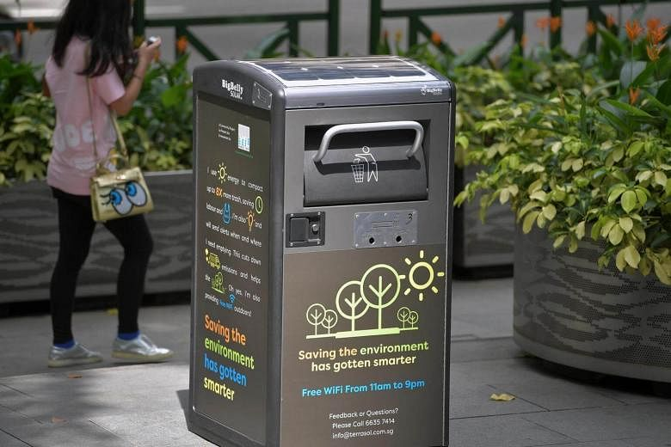
Design: Smart Bins

Slide 17
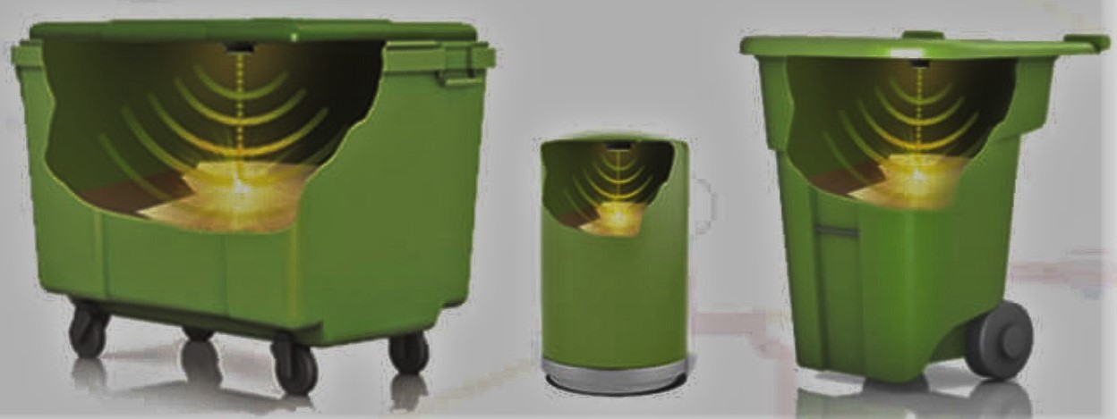
Design: Waste Level Sensors

Slide 18
SUSTAINABILITY
Efficient Resource Utilization
Reduced Overflow and Littering
Data-Driven Decision Making
Smart Bins minimize waste collection routes and therefore reduce the carbon footprint of vehicles as well as fuel consumption. Therefore, they are usually more eco-friendly than a traditional manual garbage collection method.
Smart Bins provide a convenient way to inform authorities when it’s almost time to empty the bins. This prevents the overflowing of bins and at the same time stops littering in public spaces and keeps them clean.
Through the data obtained by Smart Bins, authorities will be able to conduct analyses leading to the identification of waste production patterns. Hence, they will be able to come up with effective targeted interventions that deal with waste reduction and recycling.

Slide 19
Risk Analysis: Smart Bins
Risk Description | Impact | Likelihood | Risk =Impact x likelihood | Action
High initial investment | 3 | 2 | 6 | Seek additional funding
Public Perception | 4 | 4 | 16 | Training and grooming of public
Regulatory Compliance | 5 | 2 | 10 | Make sure to fulfill legal needs
Technology Reliability | 3 | 3 | 9 | Hire a technical expert
Cyber Security Risks | 4 | 2 | 8 | Hire Cyber Team
Data Safety | 3 | 4 | 12 | Make sure data is only accessible to admins
Web Activity monitoring | 2 | 1 | 2 | Monitor activities regularly

Slide 20
Risk Analysis: Waste level Sensors
Risk Description | Impact | Likelihood | Risk =Impact x likelihood | Action
High upfront costs | 3 | 2 | 6 | Explore financing options
Dependency on Sensors | 5 | 2 | 10 | Make sure sensors work 100%
Limited Functionality | 4 | 4 | 16 | Select the perfect location
Maintenance Requirements | 2 | 1 | 2 | Maintain regularly
Cyber Security Risks | 2 | 2 | 4 | Hire Cyber Team
Data Safety | 3 | 4 | 12 | Make sure data is only accessible to admins
Web Activity monitoring | 3 | 3 | 9 | Monitor activities regularly

Slide 21
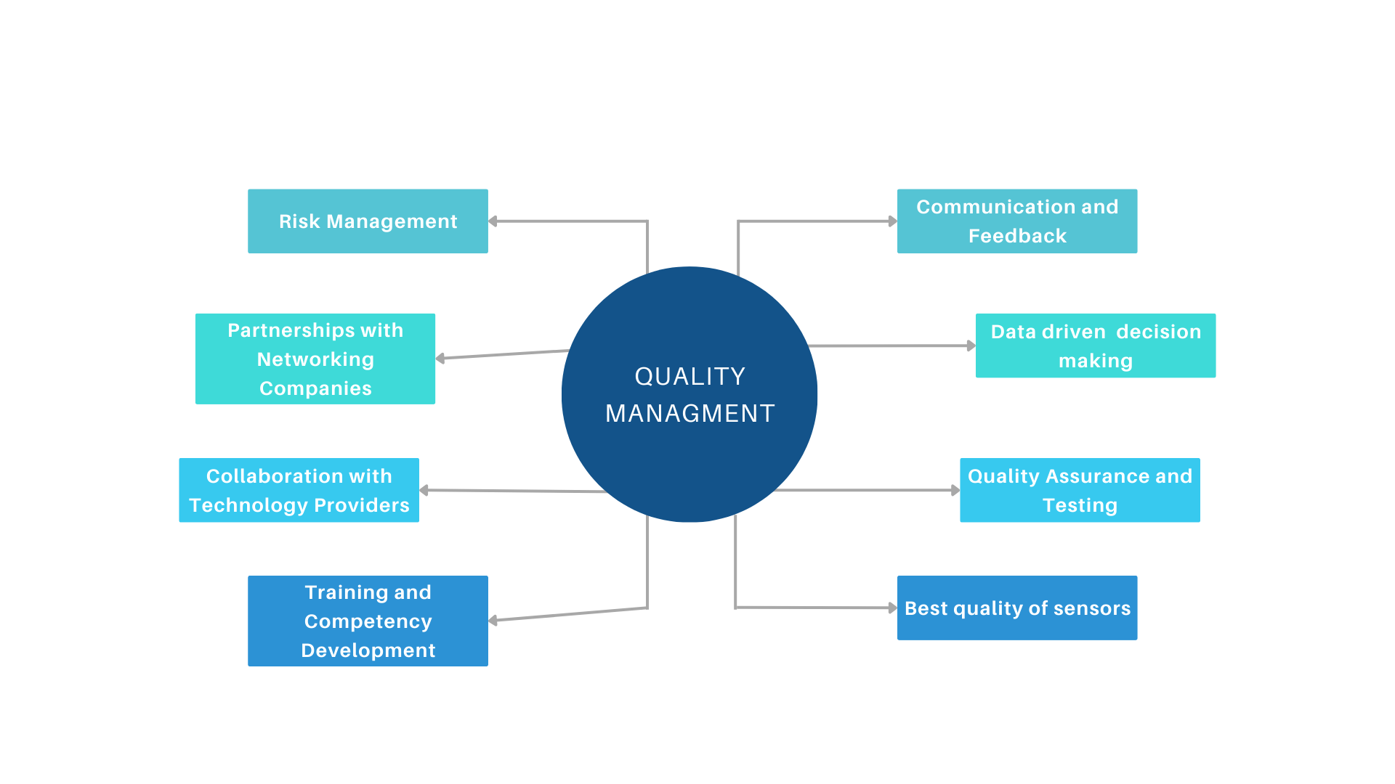
Total Quality Management Plan

Slide 22
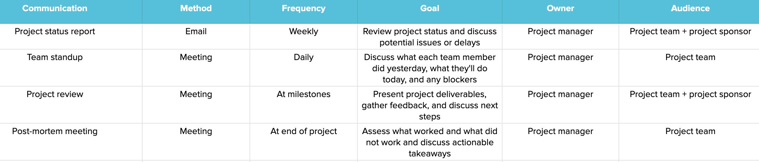
Communication Management Strategy

Slide 23
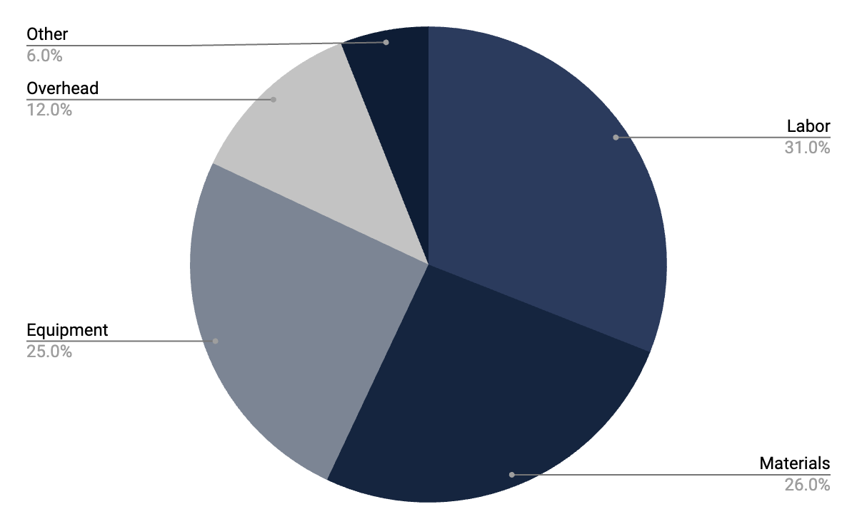
Project expenses
Staff/Labor
Materials
Equipment
Overhead
Other

Slide 24
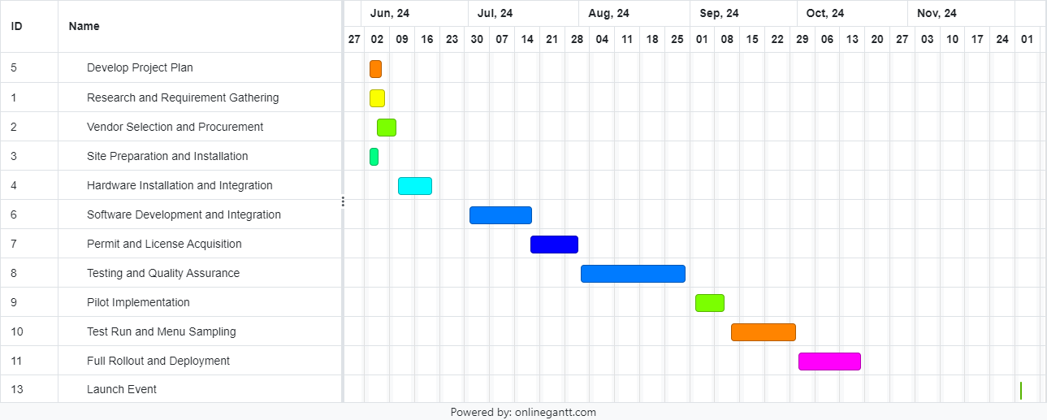
Gantt Chart

Slide 25
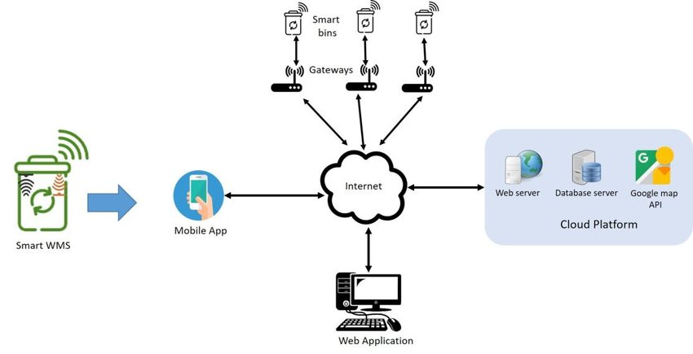
System Design

Slide 26
SMART BINS > WASTE LEVEL SENSORS
Real-Time Monitoring: The smart bins, which offer a waste management system with real-time monitoring and alerts, are the proactive waste management.
Data-Driven Decision Making: They perfect waste management by doing data collection and analysis of generation rate and administration techniques of waste.
Integrated Technology: Smart bins are advanced storage containers that can compress, utilize Wi-Fi, and display screens for increased ease of use.
Efficiency and Cost Savings: Intelligent bins reduce operational expenses and decrease environmental impacts, through the application of rate-rewinding and scheduling.

Slide 27
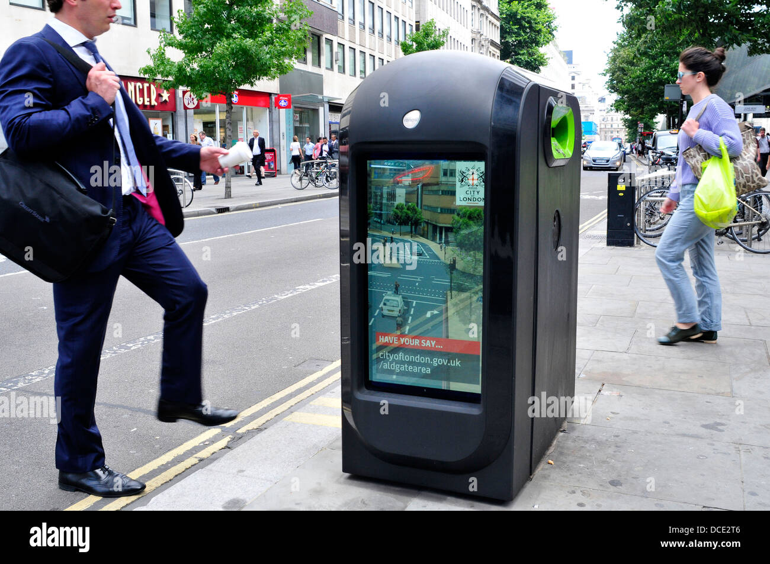
Conclusion
Smart bins and waste level sensors decision being costly, requires a different approach.
Sensor-enhanced bins give a live feed and notifications when something happens leading to improved prompt waste management.
The technical features of modern technology are very elaborate for oriented decision-making on the use of resources for efficient waste management.
Actions such as placing interactive shows (interactive shows) and Wi-Fi (Wi-Fi) likelihood are the items that teach environmental awareness Ai Bits
Smart bins are one of the major factors that prevent overflowed garbage and trash thus contributing to the hygiene of public spaces and sustainable environment.

Slide 28
References
Nikas, A.; Neofytou, H.; Karamaneas, A.; Koasidis, K.; Psarras, J. Sustainable and socially just transition to a post-lignite era in Greece: A multi-level perspective. Energy Sources Part Econ. Plan. Policy 2020, 15, 513–544.
Moumtzidou, A., Avgerinakis, K., Briassouli, A., Ioannidis, K., Vrochidis, S., & Kompatsiaris, I. (2017). "Smart Waste Management: A Review of the Use of Advanced Technologies." Journal of Sensors, 2017.
Kumar, S., & Jain, V. (2019). "IoT-based Smart Waste Management System Using Weight Sensors." Procedia Computer Science, 165, 302-309.
Lin, Y. C., Lin, J. C., & Wen, T. H. (2018). "Smart Bin System Design for Garbage Collecting System." In 2018 IEEE International Conference on Applied System Innovation (ICASI) (pp. 44-47). IEEE.

Slide 29
Product References
"Smart Bin with Compactor & Camera." Alibaba.com, 2022. [Online]. Available: https://www.alibaba.com/product-detail/Solar-Smart-Bin-with-Compactor-Camera_1600966114394.html. [Accessed: April 28, 2024].

Slide 30
THANKS

